Slide 1

FEATURES
Of java
FARISHA ASHRAF

Slide 2

TOP FEATURES OF JAVA
Simple
Object-Oriented
Platform Independent
Portable
Robust
Secure
Interpreted
Multi-Threaded

Slide 3
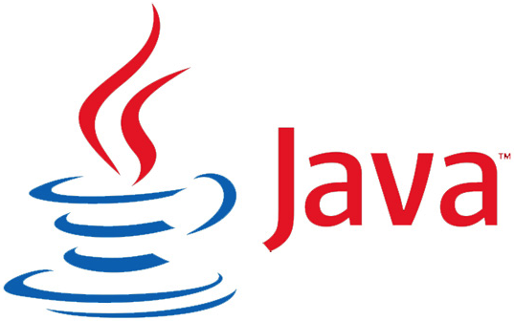

Simple
Java is a simple programming language and easy to understand because it does not contain complexities that exist in prior programming languages.
In fact, simplicity was the design aim of Javasoft peoples, because it has to work on electronic devices where less memory/resources are available.
Java contains the same syntax as in C, C++, so the programmers who are switching to Java will not face any problem in terms of syntax.
Object-Oriented
Java is an Object Oriented Programming Language, which means in Java everything is written in terms of classes and objects. Now, what is an Object? Object is nothing but a real world entity that can represent any person, place, or thing and can be distinguished from others.

Slide 4

Platform Independent
The design objective of javasoft people is to develop a language that must work on any platform. Here platform means a type of operating system and hardware technology. Java allows programmers to write their program on any machine with any configuration and to execute it on any other machine having different configurations.
Portable
The WORA (Write Once Run Anywhere) concept and platform independent feature make Java portable. Now using the Java programming language, developers can yield the same result on any machine, by writing code only once.

Slide 5

Robust
The Java Programming language is robust, which means it is capable of handling unexpected termination of a program. There are 2 reasons behind this, first, it has a most important and helpful feature called Exception Handling. If an exception occurs in java code then no harm will happen whereas, in other low level languages, the program will crash.
Secure
In today’s era, security is a major concern of every application. As now every device is connected to each other using the internet and this opens up the possibility of hacking. And this application build using java also needs some sort of security. So Java also provides security features to the programmers.

Slide 6

Interpreted
In programming languages, you have learned that they use either the compiler or interpreter, but Java programming language uses both a compiler and interpreter
Multi-Threaded
Thread is a lightweight and independent subprocess of a running program (i.e, process) that shares resources. And when multiple threads run simultaneously is called multi-threading.
* In many applications, you have seen multiple tasks running simultaneously, for example, Google Docs where while typing text, the spell check and autocorrect task are running.

